Slide 1
CS 589 Fall 2021 Lecture
Frontier topics
Monday 6:30-9:00
Babbio 122
photo: https://www.scubedstudios.com/information-retrieval/
Notes:
In this lecture, we will be talking about probabilistic ranking models, which is

Slide 2
Frontier topics
Language model compression for language models
More on AutoML
Language models for text generation
Testing of NLP models
Notes:
For the simplest method for learning to rank, we can simply leverage a binary classification or a regression algorithm, where in classification, we retrieve the documents where the predicted label is 1, and in regression, we rank the documents based on their predicted score.
Next we talked about two learning to rank algorithms, i.e., MART and RankNet.

Slide 3
CS 589 Fall 2021 Lecture
Knowledge distillation for language models
Monday 6:30-9:00
Babbio 122
source: "Compression of Deep Learning Models for NLP”, Gupta et al. 2020
photo: https://www.scubedstudios.com/information-retrieval/
Notes:
In this lecture, we will be talking about probabilistic ranking models, which is

Slide 4
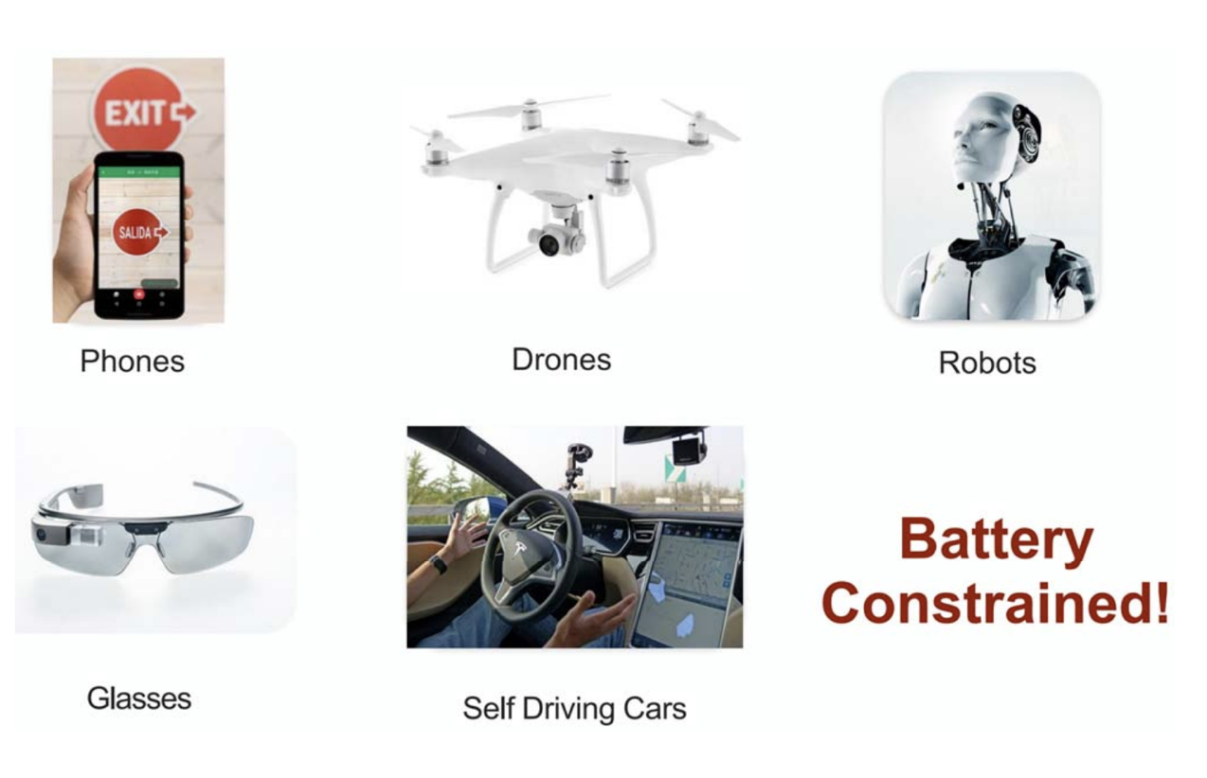
Deep learning on mobile/IoT devices
Notes:
Due to the power of language modling, these days, language models are now also deployed on low cost devices such as mobile and IoT devices. For example, When using a speech recognition app, it may be using a language model that is stored locally by the device.

Slide 5
Deep learning on mobile/IoT devices
355 GPU year w/ V100
4.6 million $
Notes:
However, large language models are too big to be deployed to low resource settings. For example, GPT3 contains 175B parameters. GPT3 was reported to have cost 4.6 million. It would take 355 GPU year.

Slide 6

Deep learning on mobile/IoT devices
GPU rams
Can only run models up to the RAM of GPU
Latency requirements
Applications deploying to large number of users, e.g., Google
Mobile-first computational requirements
Apps > 150MB will receive much more scrutiny
Cloud computing
Cost for renting GPUs
Notes:
On the other hand, it's hard for mobile and IoT device to store a model whose size is larger than 150MB. To solve this problem, one solution is to compress the large model into a smaller one, which is called knowledge distillation.

Slide 7
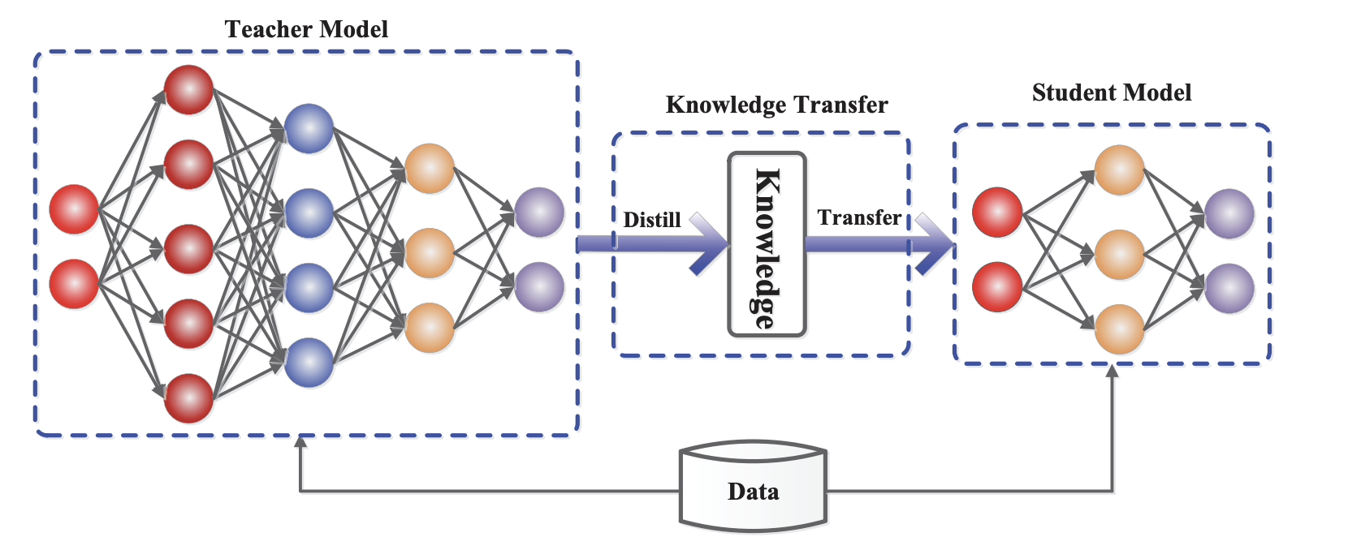
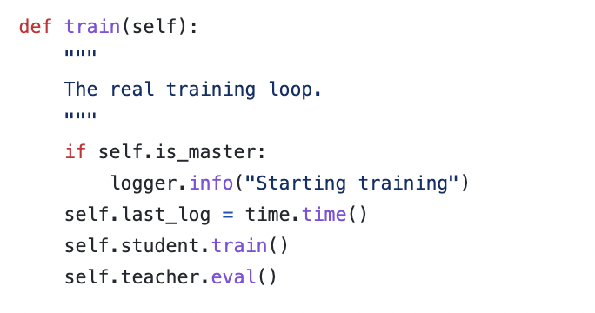
Knowledge distillation: student-teacher framework
Teacher model: the larger, cumbersome model
Student model: the smaller model that learns from the teacher
Knowledge transfer: train the student model to learn from the teacher's predictions on the data
# train the student parameter
# use the teacher model for prediction
source: "Knowledge Distillation: A Survey”, Gou et al. 2019
Notes:
we use Google playstore data as the data source, so we collect these data, we clean it, we split the sentence, and we build a filtering algorithm to select the high quality sentence

Slide 8
Is knowledge distillation is useful?
Knowledge distillation is not necessarily useful
Without the teacher, we can still train the student model with the same data
Training the teacher takes extra time
We have to show that the result of distilling a larger model to the smaller model > training the smaller model [Hinton et al. 2015]
Ditilling the knowledge in a neural network, Hinton et al. 2015
Notes:
we use Google playstore data as the data source, so we collect these data, we clean it, we split the sentence, and we build a filtering algorithm to select the high quality sentence

Slide 9
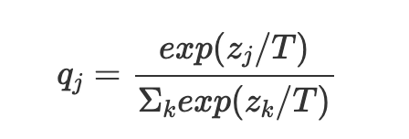
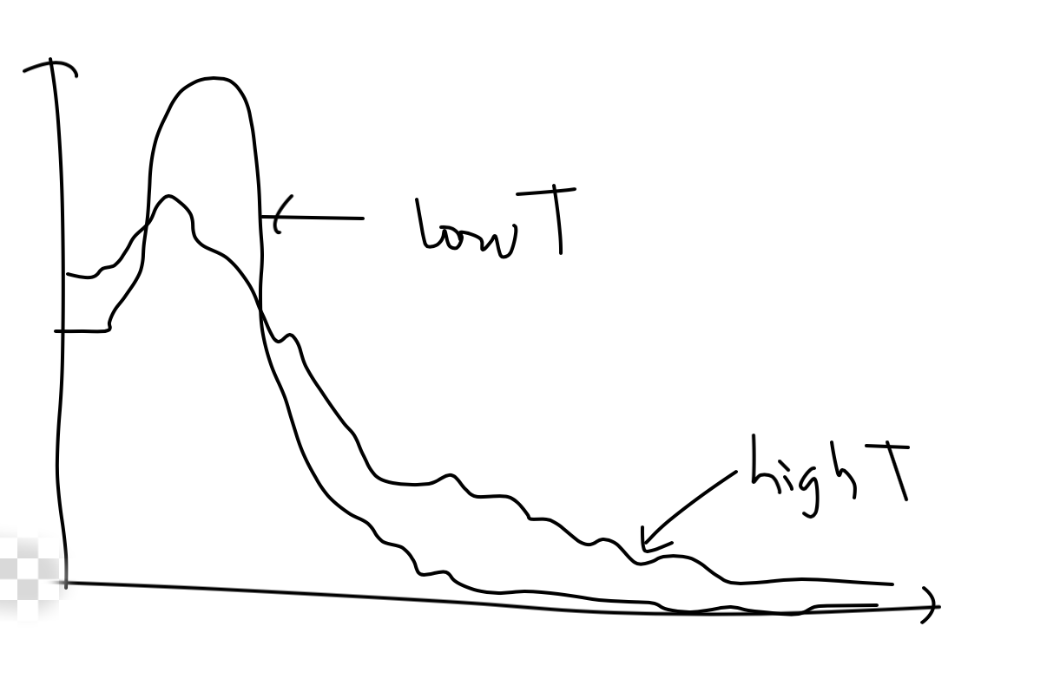
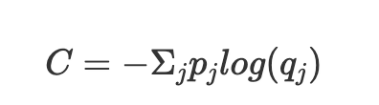
Knowledge distillation with the temperature T
Hinton et al. first proposed the term of "knowledge distillation"
Training the student network to match the teacher model's logits:
Student network: qi and zi
Teacher network: pi and vi
Minimizing the cross entropy loss between pi and qi:
T: temperature parameter
Ditilling the knowledge in a neural network, Hinton et al. 2015
Notes:
https://hackmd.io/@Raj-Ghugare/ryUfg7Qkw

Slide 10
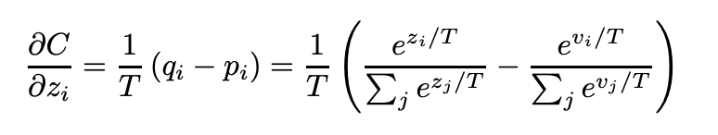
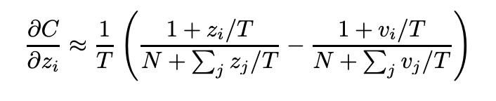
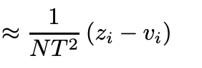
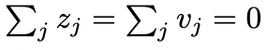
Effect of the temperature parameter T
Compute the gradient of C w.r.t. z (derivation can be found on https://hackmd.io/@Raj-Ghugare/ryUfg7Qkw):
When T is high (similar to optimizing the square loss):
When T is low:
Focus less on matching the very negative logits
When the gap between model size is large, intermediate T is useful for ignoring the very negative logits
when
Notes:
https://hackmd.io/@Raj-Ghugare/ryUfg7Qkw

Slide 11
Knowledge distillation: Preliminary experiment on MNIST
Data:
60k training examples
When the distilled net has > 300 units, all temperatures above 8 gave fairly similar results
When radically reduced to 30 units, T from 2.5 to 4 works better
Even if a digit is omitted in the data, the distilled model still learns to recognize it even if the learned bias on the cumbersome model is high
Cumbersome model
2 hidden layers
1200 ReLU units
regularization
67 errors
Small model
2 hidden layers
800 ReLU units
no regularization
146 errors
Distillation with T=20: 74 errors
Notes:
https://hackmd.io/@Raj-Ghugare/ryUfg7Qkw

Slide 12
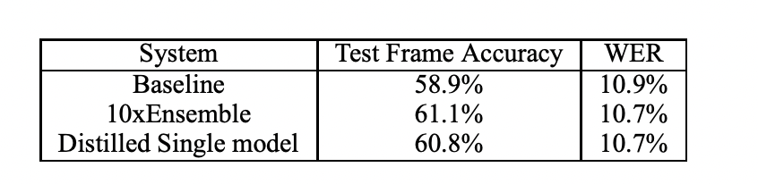
Knowledge distillation: Experiments on ASR
Data:
700M training examples/2k hours
Models:
Teacher model: a strong baseline used by Android voice search, with 85M parameters
Distillation: distilling 10xensembled teachers, i.e., 10 specialists model to a single student model
The distilled single model outperforms the baseline with the same amount of parameters
Ditilling the knowledge in a neural network, Hinton et al. 2015
Notes:
https://hackmd.io/@Raj-Ghugare/ryUfg7Qkw

Slide 13
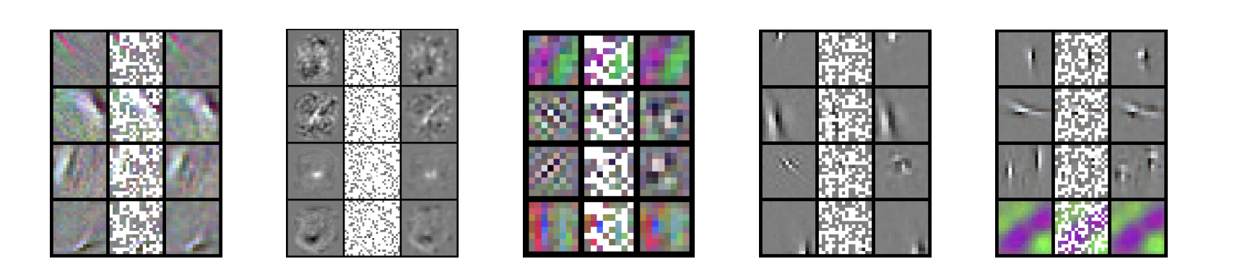
Explaining the why behind knowledge distillation
How can smaller model learn more by distilling?
Significant redundancy in neural network models
Representing the value of each pixel in the feature separately is redundant
Since it is highly likely that the value of a pixel will be equal to a weighted average of its neighbors
Predicting 95% parameters w/o loss in accuracy
original features
random selected features
predicted features
(1) convnet trained on STL-10
(2) MLP
(3) convnet trained on cifar
(4) reconstruction ICA on Hyvarinen’s dataset
(5) reconstruction ICA on STL-10
source: "Predicting parameters in deep learning.”, Denil et al. 2013
Notes:
we use Google playstore data as the data source, so we collect these data, we clean it, we split the sentence, and we build a filtering algorithm to select the high quality sentence

Slide 14
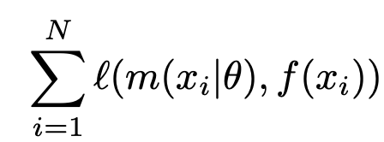
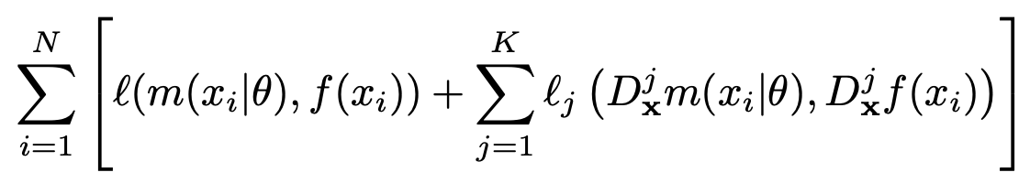
Training students to learn beyond logits
So far we have been using the logits (output layer of softmax) only
However it is becoming common to have access to derivatives of the target output
Optimizing the network to not only approximate the function’s output but also the derivatives
Universal approximation theorem [Honik et al. 1991] in the Sobolev space, i.e., metric difference not only defined by value but also derivatives
traditional training
Sobolev training
source: “Sobolev Training for Neural Networks”, Czarnecki et al. 2015
Notes:
we use Google playstore data as the data source, so we collect these data, we clean it, we split the sentence, and we build a filtering algorithm to select the high quality sentence

Slide 15
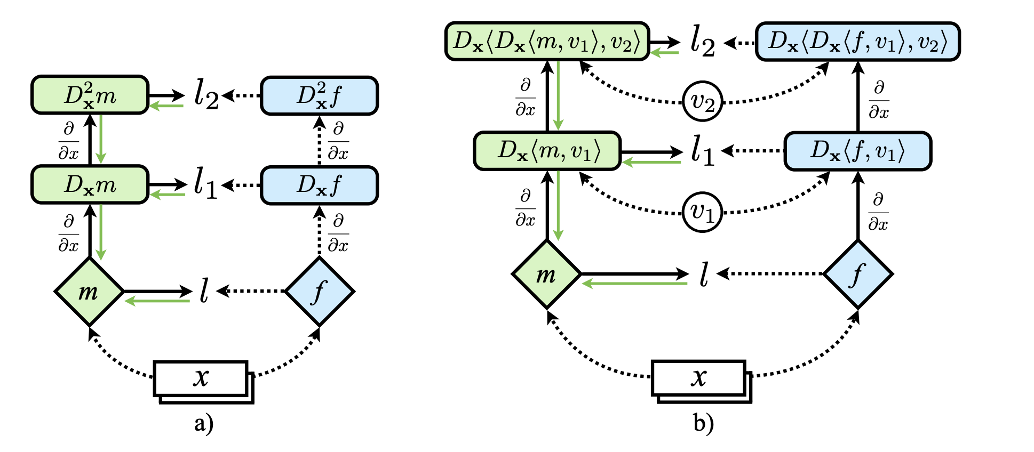
Training students to learn beyond logits
Left: Sobolev Training of order 2. Diamond nodes m and f indicate parameterized functions, where m is trained to approximate f. Green nodes receive supervision.
Right: stochastic Sobolev Training. If f and m are multivariate functions, the gradients are Jacobian matrices. To avoid computing high dimensional objects, compute and fit their projections on a random vector vj
source: “Sobolev Training for Neural Networks”, Czarnecki et al. 2015
Notes:
we use Google playstore data as the data source, so we collect these data, we clean it, we split the sentence, and we build a filtering algorithm to select the high quality sentence

Slide 16
Reducing the embedding models for language models
Distillation can help reduce the size of pretrained language models
However, previous work has not considered reducing vocabulary size
The word embedding table of bert-base accounts for 21% of the model size, teacher: 30K, student: ~3k
Can we reduce the size of vocabulary?
Poses a challenge, since existing trainings all assume the teacher and student share the same vocabulary
Use two strategies: dual training and shared variable projection to reduce the model to x61 in size
source: “Extreme language model compression with optimal subwords and shared project”, Zhao et al. 2020
Notes:
we use Google playstore data as the data source, so we collect these data, we clean it, we split the sentence, and we build a filtering algorithm to select the high quality sentence

Slide 17
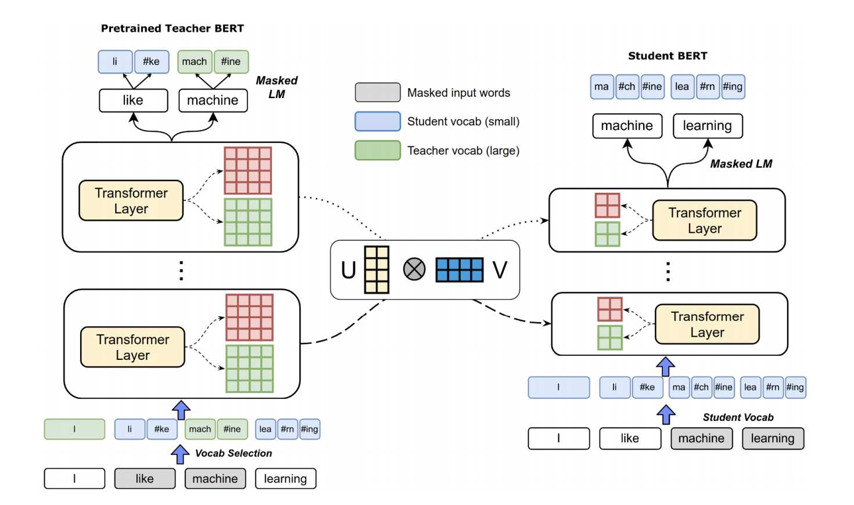
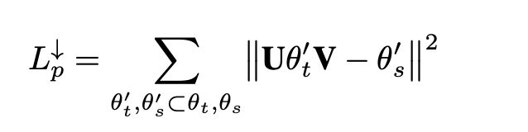
Reducing the embedding models for language models
Teacher has a mixture of vocabulary from student and teacher
Forces the model to learn to predict words from student vocab using teacher vocab, and vice versa
Projecting model parameters into the same space to encourage alignment
source: “Extreme language model compression with optimal subwords and shared project”, Zhao et al. 2020
Notes:
we use Google playstore data as the data source, so we collect these data, we clean it, we split the sentence, and we build a filtering algorithm to select the high quality sentence

Slide 18
ALBERT: a lite bert for self-supervised learning of language representations
Factorized embedding parameterization (horizontal)
Decomposing the large vocabulary embedding matrix into two small matrices, makes it easier to grow the hidden size from vocab size
Cross-layer parameter sharing (vertical)
e.g., only sharing FFN parameters, or only sharing attention
An ALBERT config similar to BERT-large has 18x fewer parameters and can train 1.7x times faster
Achieving SOTA on GLUE, SQUAD 2.0, and RACE
source: “ALBERT: a lite bert for self-supervised learning of language representations”, Lan et al. 2020
Notes:
we use Google playstore data as the data source, so we collect these data, we clean it, we split the sentence, and we build a filtering algorithm to select the high quality sentence

Slide 19
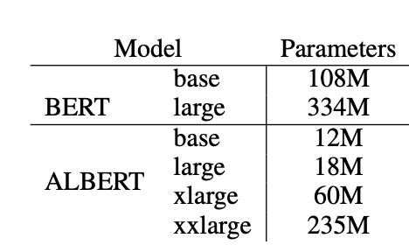
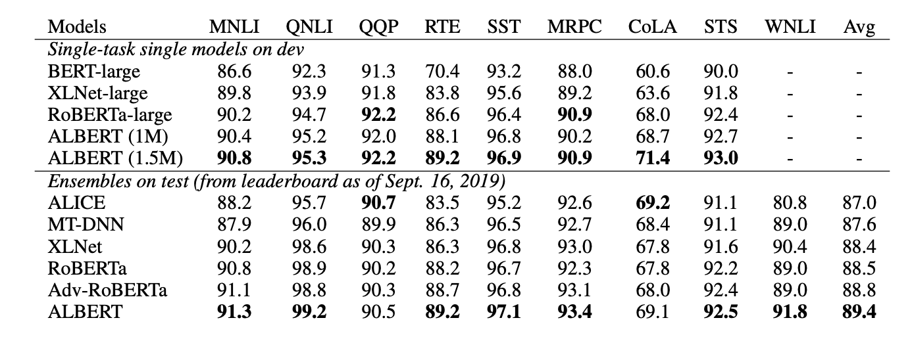
ALBERT: a lite bert for self-supervised learning of language representations
The parameter reduction techniques also act as a form of regularization that stabilizes the training and helps with generalization.
source: “ALBERT: a lite bert for self-supervised learning of language representations”, Lan et al. 2020
Notes:
we use Google playstore data as the data source, so we collect these data, we clean it, we split the sentence, and we build a filtering algorithm to select the high quality sentence

Slide 20
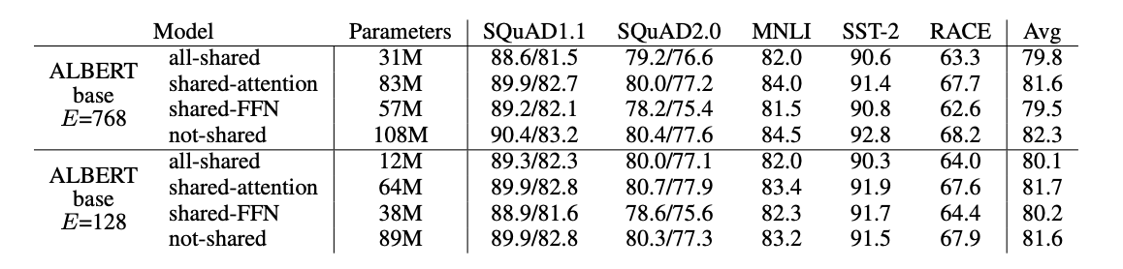
ALBERT: a lite bert for self-supervised learning of language representations
The effect of different cross-layer parameter sharing strategies:
Shared attention has better performance than the other two
source: “ALBERT: a lite bert for self-supervised learning of language representations”, Lan et al. 2020
Notes:
we use Google playstore data as the data source, so we collect these data, we clean it, we split the sentence, and we build a filtering algorithm to select the high quality sentence

Slide 21
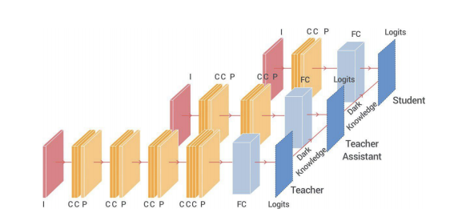
Knowledge distillation with teacher assistant
Student network performance degrades when the gap between student and teacher is large
Given a fixed student network, one cannot employ an arbitrarily large teacher
A teacher can effectively transfer its knowledge to students up to a certain size, not smaller
TA models are distilled from the teacher, and the student is then only distilled from the TAs, i.e., chain distillation
source: “Improved Knowledge Distillation via Teacher Assistant”, Mirzadeh et al. 2020
Notes:
we use Google playstore data as the data source, so we collect these data, we clean it, we split the sentence, and we build a filtering algorithm to select the high quality sentence

Slide 22
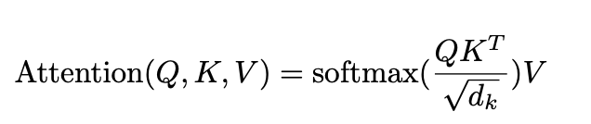
Reformer
Replace dot‐product attention by LSH, O(𝐿􏰄^2) -> O(LlogL), where L is the length of the sequence.
Hashing attention. We mainly need to compute the QK^T, but note we mainly need to compute the softmax, which is dominated by the largest elements
For each query qi only need to focus on keys in K that are closest to qi
Use reversible residual layers, which allows storing activations only once in the training process instead of N times (N is the number of layers)
source: “REFORMER: THE EFFICIENT TRANSFORMER”, Kitaev et al. 2020
Notes:
we use Google playstore data as the data source, so we collect these data, we clean it, we split the sentence, and we build a filtering algorithm to select the high quality sentence

Slide 23
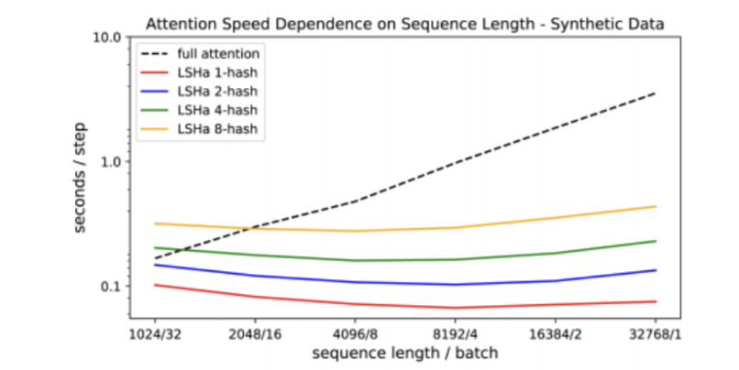
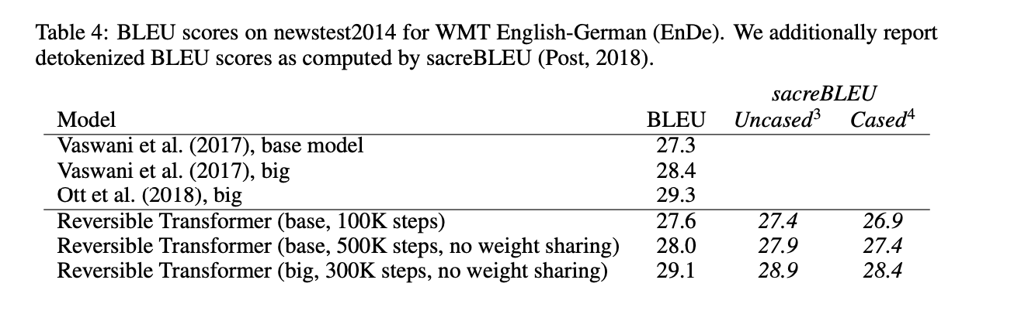
Reformer
Performance of reformer on efficiency and accuracy
source: “REFORMER: THE EFFICIENT TRANSFORMER”, Kitaev et al. 2020
Notes:
we use Google playstore data as the data source, so we collect these data, we clean it, we split the sentence, and we build a filtering algorithm to select the high quality sentence

Slide 24
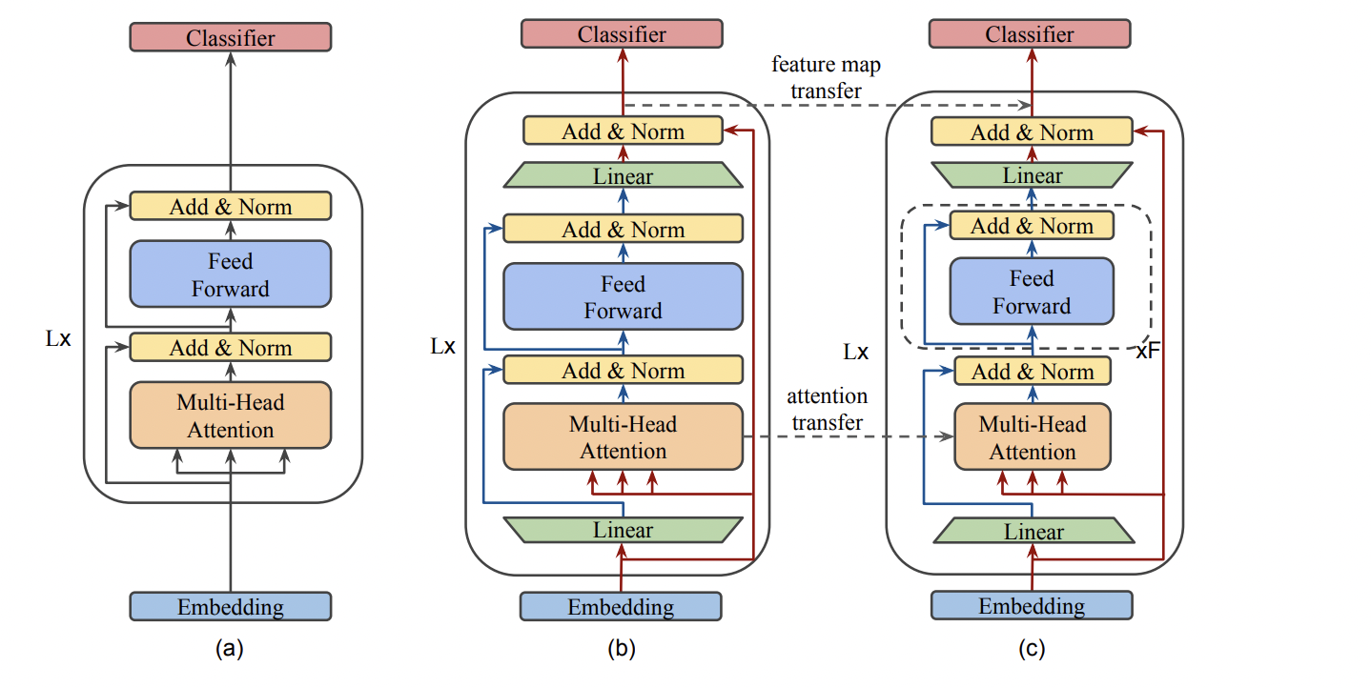
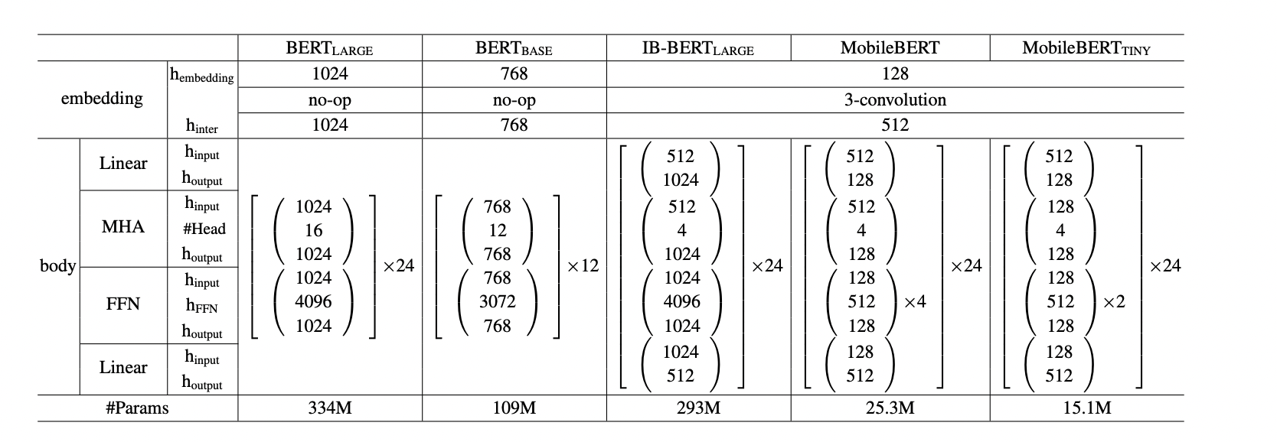
MobileBERT
Task agnostic lightweight BERT model
Task-specific BERT: distill model on a specific task
However, this is inefficient because for another task, we need to retrain the model
Distilling BERT to a deep, thin network
It is difficult to train a deep and thin network (bottleneck)
Teacher: BERT-large augmented with the thin network
(a) BERT; (b) Inverted-Bottleneck BERT (IB-BERT); and (c) MobileBERT
source: “MobileBERT: a Compact Task-Agnostic BERT for Resource-Limited Devices”,
Notes:
we use Google playstore data as the data source, so we collect these data, we clean it, we split the sentence, and we build a filtering algorithm to select the high quality sentence

Slide 25
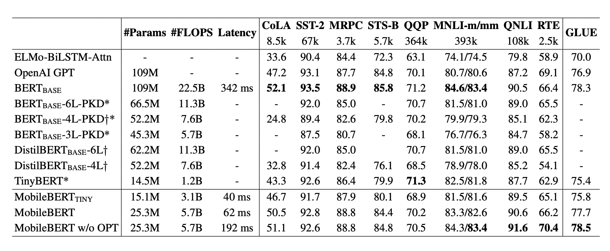
MobileBERT: Performance
source: “MobileBERT: a Compact Task-Agnostic BERT for Resource-Limited Devices”,
Notes:
we use Google playstore data as the data source, so we collect these data, we clean it, we split the sentence, and we build a filtering algorithm to select the high quality sentence

Slide 26
CS 589 Fall 2021 Lecture
NAS
Monday 6:30-9:00
Babbio 122
photo: https://www.scubedstudios.com/information-retrieval/
Notes:
In this lecture, we will be talking about probabilistic ranking models, which is

Slide 27
Neural network architectures
Notes:
we use Google playstore data as the data source, so we collect these data, we clean it, we split the sentence, and we build a filtering algorithm to select the high quality sentence

Slide 28
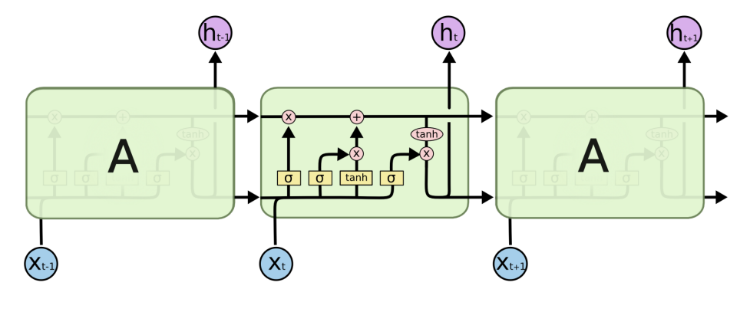
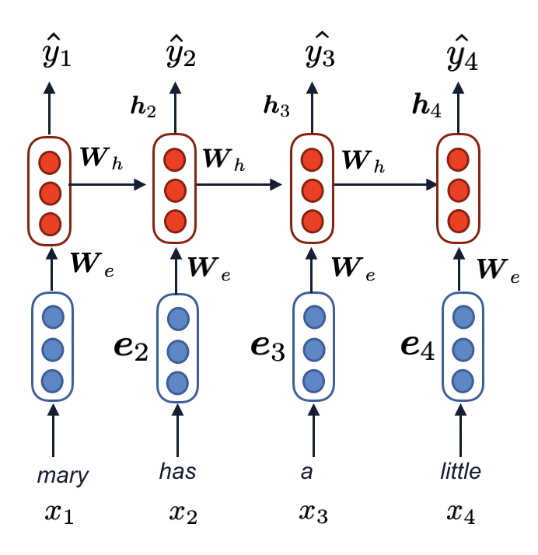
Neural network architectures
Notes:
we use Google playstore data as the data source, so we collect these data, we clean it, we split the sentence, and we build a filtering algorithm to select the high quality sentence

Slide 29
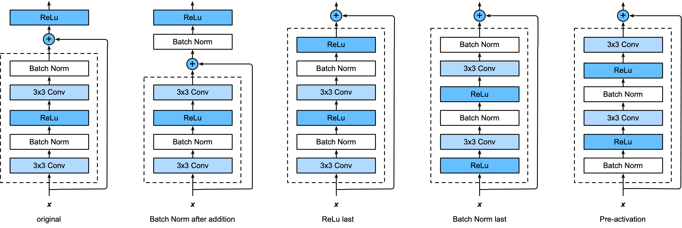
Neural network architectures
Neural architectures are important in determining model performance
Depth and width [Lu et al. 2017]
Pooling, convolution, dilated convolution, skip connections [He et al. 2015]
source: “The Expressive Power of Neural Networks: A View from the Width”, Lu et al. 2017
Notes:
we use Google playstore data as the data source, so we collect these data, we clean it, we split the sentence, and we build a filtering algorithm to select the high quality sentence

Slide 30

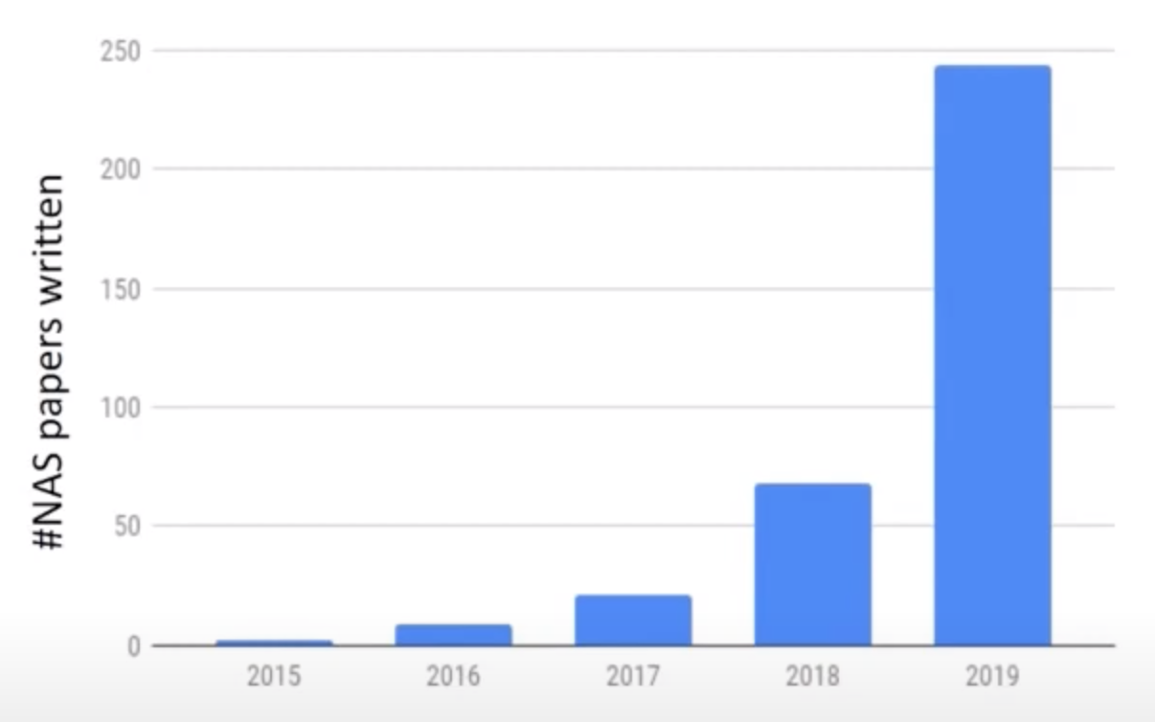
NAS: an exploding area
automl.org
“Neural architecture search with reinforcement learning” by Zoph & Le
source: Frank Hutter’s talk “Neural architecture search: coming of an age”
Notes:
we use Google playstore data as the data source, so we collect these data, we clean it, we split the sentence, and we build a filtering algorithm to select the high quality sentence

Slide 31
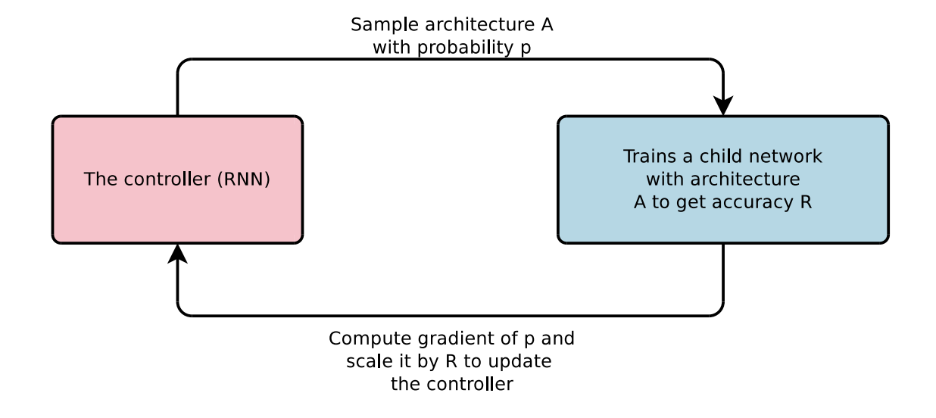
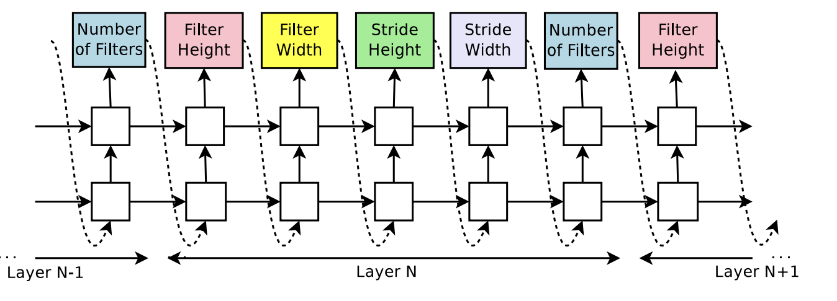
Neural architecture search with reinforcement learning
Use an RNN to generate the neural architecture
Use test accuracy as reward for controller actions with policy gradient
On CIFAR-10, starting from scratch, can design a novel network architecture that rivals the best human-invented architecture
source: “Neural architecture search with reinforcement learning”, So et al. 2017
Notes:
we use Google playstore data as the data source, so we collect these data, we clean it, we split the sentence, and we build a filtering algorithm to select the high quality sentence

Slide 32
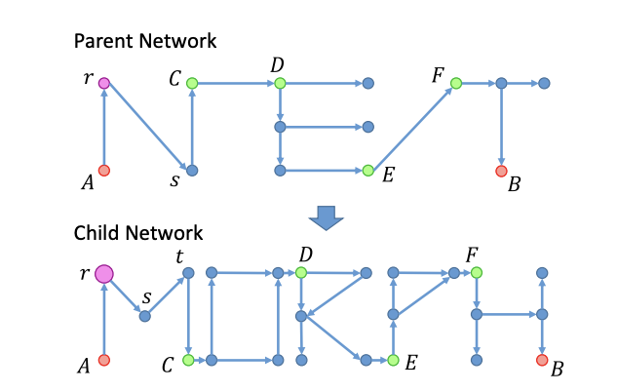
Network morphism
Morphism:
A structure-preserving map from one math structure to another
Type 1: Depth morphism
s -> s + t
Type 3: Subnet morphing
subnet embedded in segment CD
Type 2: width and kernel size morphing
source: “Network morphism”, Wei et al. 2016
Notes:
we use Google playstore data as the data source, so we collect these data, we clean it, we split the sentence, and we build a filtering algorithm to select the high quality sentence

Slide 33
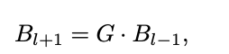
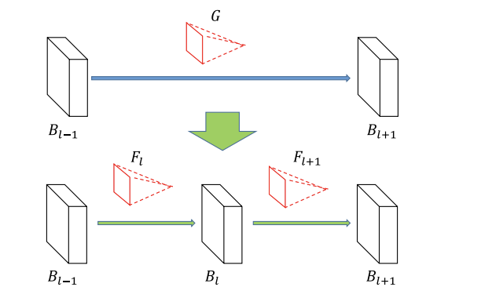
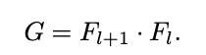
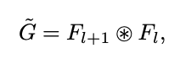
Network morphism as matrix factorization
In a fully connected network:
Adding a new layer = matrix factorization
In a convolutional network, similarly:
parent network
child network
Notes:
we use Google playstore data as the data source, so we collect these data, we clean it, we split the sentence, and we build a filtering algorithm to select the high quality sentence

Slide 34
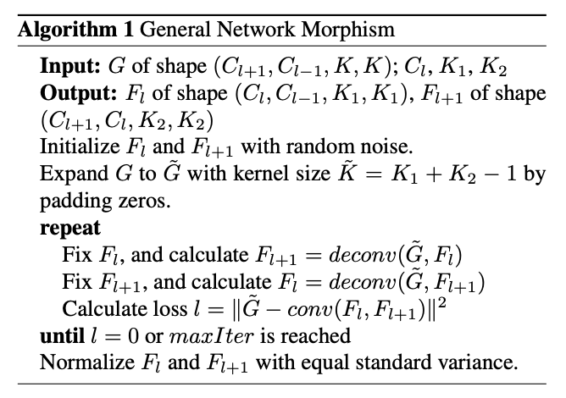
Morphism algorithms: Solving matrix factorization for linear case
Desiderata for morphism algorithms
Parameters contain as many 0 as possible
Parameters need to be in a consistent scale
Introduces two algorithms for morphism:
Initialize matrices with random noise
Iteratively perform the decomposition/deconvolution for one layer with another layer fixed
source: “Network morphism”, Wei et al. 2016
Notes:
we use Google playstore data as the data source, so we collect these data, we clean it, we split the sentence, and we build a filtering algorithm to select the high quality sentence

Slide 35

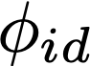
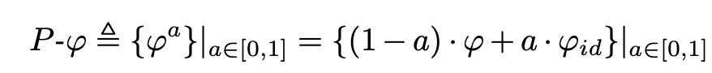
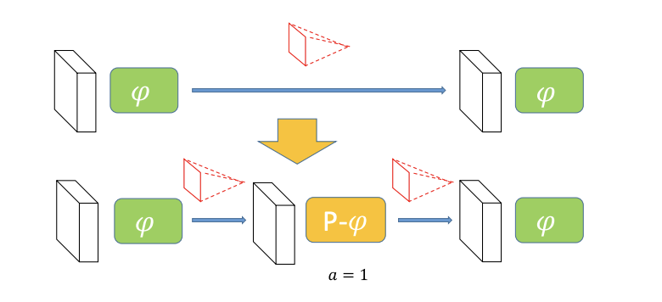
Morphism algorithm: Handling non-linear case
With a non-linear activation function :
Define a family of P-activation function to handle arbitrary continuous non-linear activation is the identity mapping:
Activations in yellow needs to be set as linear
at the beginning, then grow into a non-linear
Notes:
we use Google playstore data as the data source, so we collect these data, we clean it, we split the sentence, and we build a filtering algorithm to select the high quality sentence

Slide 36
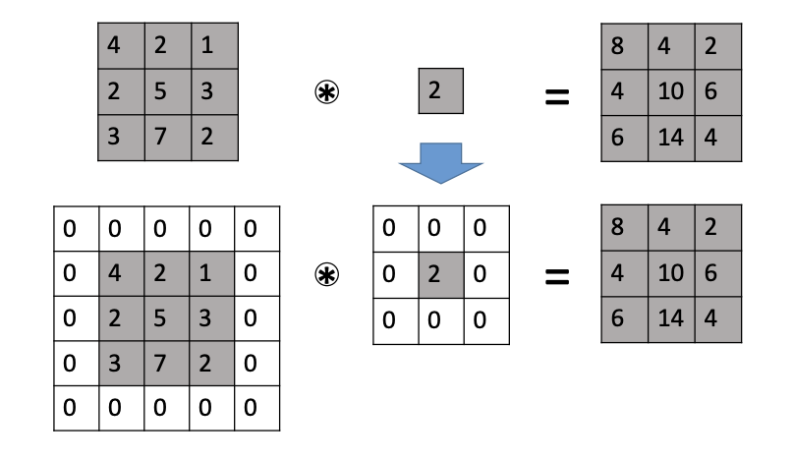
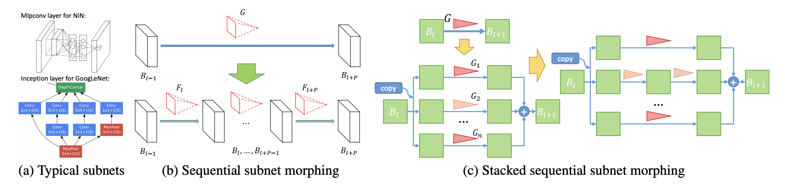
Morphism algorithm: Other morphing
Kernel size morphing
Both filters and blobs are padded with the same size of zeros to keep the final results unchanged
Subnet morphing
source: “Network morphism”, Wei et al. 2016
Notes:
we use Google playstore data as the data source, so we collect these data, we clean it, we split the sentence, and we build a filtering algorithm to select the high quality sentence

Slide 37
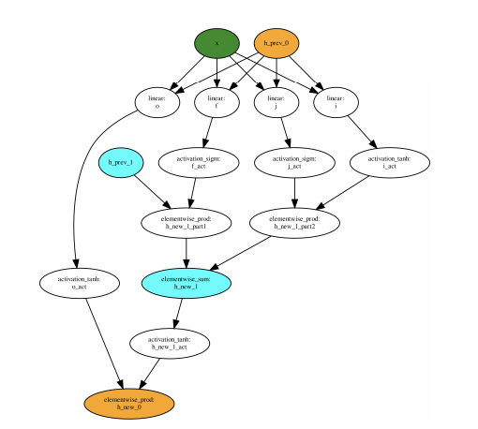
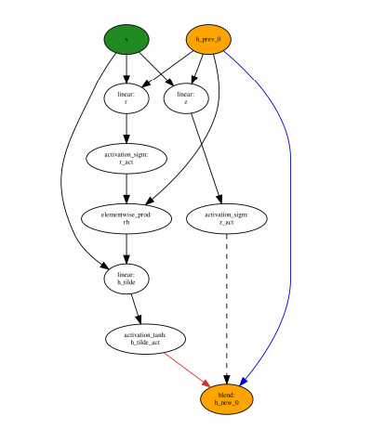
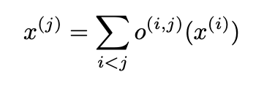
DARTS: differentiable architecture search
Search space
The inner structure of a cell
Cell can be stacked into a CNN or recursively connected to an RNN
Each intermediate node is computed based on all its predecessors
LSTM cell
GRU cell
source: “DARTS: differentiable architecture search”, Liu et al. 2019
Notes:
we use Google playstore data as the data source, so we collect these data, we clean it, we split the sentence, and we build a filtering algorithm to select the high quality sentence

Slide 38

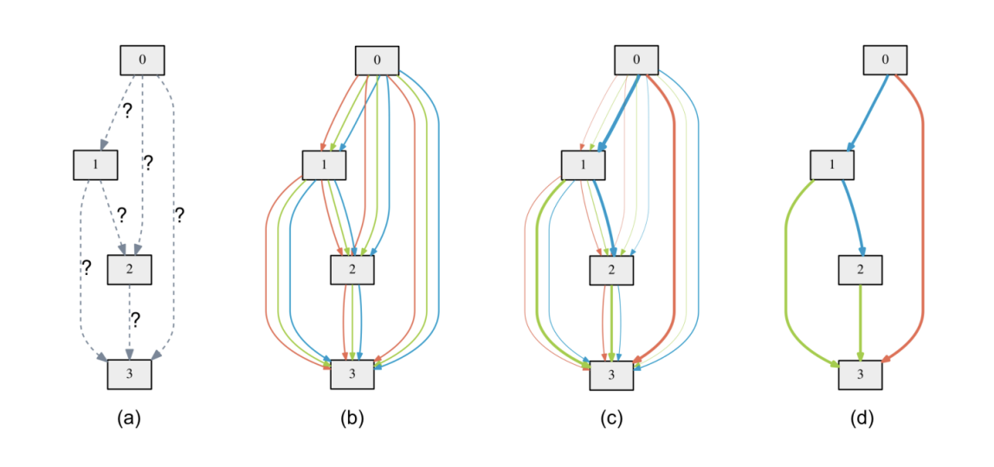
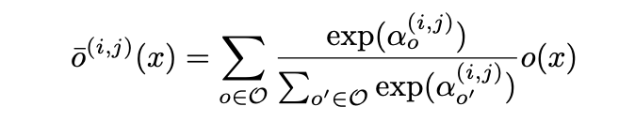
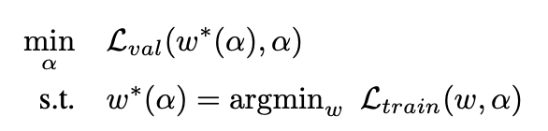
DARTS: differentiable architecture search
Relax the discrete problem -> continuous
One-shot model with continuous architecture weight (mixing weight) for each operator:
Solving a bi-level optimization problem
5x5 col
3x3 col
maxpooling
Iterative updating alpha and w using gradient based methods
source: “DARTS: differentiable architecture search”, Liu et al. 2019
Notes:
we use Google playstore data as the data source, so we collect these data, we clean it, we split the sentence, and we build a filtering algorithm to select the high quality sentence

Slide 39

Auto-Pytorch: Joint hyperparameter optimization and NAS
Auto-pytorch-tabular: making deep learning easily accessible to tabular dataset for Pytorch
Search space
7 hyper parameters
shaped MLP + shaped ResNet
source: “Auto-PyTorch Tabular: Multi-Fidelity MetaLearning for Efficient and Robust AutoDL”, Zimmer et al. 2020
Notes:
we use Google playstore data as the data source, so we collect these data, we clean it, we split the sentence, and we build a filtering algorithm to select the high quality sentence

Slide 40


Auto-Keras
Proposes to use Bayesian optimization for neural architecture search
Challenge applying BO to NAS as BO is designed only for the Euclidean space
If BO samples an architecture, it may cause input shape inconsistency
Proposes an edit-distance neural network kernel
Use dynamic programming-based morphing:
source: “Auto-Keras: An Efficient Neural Architecture Search System”, Jin et al. 2019
Notes:
we use Google playstore data as the data source, so we collect these data, we clean it, we split the sentence, and we build a filtering algorithm to select the high quality sentence

Slide 41


Auto-Weka
Combined algorithm selection and hyperparameter optimization problem (CASH) as computing
Uses two hyperparameter optimization algorithm that can handle hyperparameter search in a hierarchical space
Sequential model-based configuration
Tree-structured Parzen estimator
source: “Auto-WEKA: Combined Selection and Hyperparameter Optimization of Classification Algorithms”, Thornton et al. 2013
Notes:
we use Google playstore data as the data source, so we collect these data, we clean it, we split the sentence, and we build a filtering algorithm to select the high quality sentence

Slide 42

Low-cost Proxy for NAS
NAS is expensive
Use a low-cost proxy for predicting and reducing the cost of NAS
Mean gram matrix can serve as the proxy [Yuan et al. 2016]
Use gram matrix as the proxy to eliminate most candidate architecture and only use the top-k
source: “KNAS: Green Neural Architecture Search”, Xu et al. 2019
Notes:
we use Google playstore data as the data source, so we collect these data, we clean it, we split the sentence, and we build a filtering algorithm to select the high quality sentence

Slide 43

Low-cost Proxy for NAS
NAS is expensive
Use a low-cost proxy for predicting and reducing the cost of NAS
Mean gram matrix can serve as the proxy [Yuan et al. 2016]
Use gram matrix as the proxy to eliminate most candidate architecture and only use the top-k
source: “KNAS: Green Neural Architecture Search”, Xu et al. 2019
Notes:
we use Google playstore data as the data source, so we collect these data, we clean it, we split the sentence, and we build a filtering algorithm to select the high quality sentence

Slide 44
Using supernet to reduct the cost
NAS is expensive
We can train a supernet, and search within the subset of the supernet for NAS
Only train one time, weight is shared across all subsets
source: “HOW DOES WEIGHT SHARING HELP IN NEURAL ARCHITECTURE SEARCH?”, Zhang et al. 2019
Notes:
we use Google playstore data as the data source, so we collect these data, we clean it, we split the sentence, and we build a filtering algorithm to select the high quality sentence

Slide 45
CS 589 Fall 2021 Lecture
Other language models
Monday 6:30-9:00
Babbio 122
photo: https://www.scubedstudios.com/information-retrieval/
Notes:
In this lecture, we will be talking about probabilistic ranking models, which is

Slide 46
RoBERTa [Liu et al. 2019]
RoBERTa: A Robustly Optimized BERT Pre-training Approach (Liu et al, University of Washington and Facebook, 2019)
An ablation study on BERT for design choices:
Static vs. dynamic masking
Sentence completeness:
segment pair + NSP, sentence pair + NSP, full sentences, doc sentences
Larger batch sizes
batch size = 256, 2K, 8K
Larger BPE vocab
roberta -> “ro” “bert” “a##”
50K subword units
Notes:
we use Google playstore data as the data source, so we collect these data, we clean it, we split the sentence, and we build a filtering algorithm to select the high quality sentence

Slide 47
RoBERTa fine tuning on GLUE
Two settings for fine-tuning GLUE
Single task on dev
batch size {16, 32}
lr = {1e-5, 2e-5, 3e-5}
linear warmup for the first 6% of steps
Ensemble on test
For RTE, STS-B & MRPC, helpful to fine tune starting from model fine-tuned on MNLI
Run 15 different seeds for the selected hyperparam, and ensemble top 7 model based on dev set metrics
Notes:
we use Google playstore data as the data source, so we collect these data, we clean it, we split the sentence, and we build a filtering algorithm to select the high quality sentence

Slide 48


RoBERTa results
Notes:
we use Google playstore data as the data source, so we collect these data, we clean it, we split the sentence, and we build a filtering algorithm to select the high quality sentence

Slide 49

XLNet [Yang et al. 2019, CMU and Google]
Innovation #1: Relative position embeddings
Sentence: John ate a hot dog
Relative attention: “How much should dog attend to hot (in any position) and how much should dog attend to the previous word?”
Innovation #2: Randomly permute the training sequences
Training with more data and larger models..
Notes:
we use Google playstore data as the data source, so we collect these data, we clean it, we split the sentence, and we build a filtering algorithm to select the high quality sentence

Slide 50
CS 589 Fall 2021 Lecture
Language model for Seq2seq
Monday 6:30-9:00
Babbio 122
photo: https://www.scubedstudios.com/information-retrieval/
Notes:
In this lecture, we will be talking about probabilistic ranking models, which is

Slide 51
BERT: Bidirectional encoder using Transformers
Architecture:
12 layers of Transformer architecture
Training objective:
Masked language model (randomly masking 15% of tokens, predicting the token using both the left and right tokens)
Next sentence prediction
Pre-training data: the BooksCorpus (800M words) (Zhu et al., 2015) and English Wikipedia (2,500M words)
BERT architecture is not designed for seq2seq generation task: why not?

Slide 52
Transformer
Non-recurrent sequence to sequence encoder-decoder model
Encoder and decoder architectures
Multi-head self attention [Lin et al. 2017]
Position encoding [Gehring et al. 2017]
Attention is all you need. Vaswani et al. 2017
Notes:
we use Google playstore data as the data source, so we collect these data, we clean it, we split the sentence, and we build a filtering algorithm to select the high quality sentence

Slide 53
GPT: Left-to-right decoder using the Transformer arch.
The GPT architecture also uses the transformer architecture
But it uses the decoder (masked multi-head attention) to allow autoregressive generation for seq2seq tasks
Masked multi-head attention prevents decoder from attending to right tokens
Framework:
Unsupervised pre-training: using the BooksCorpus + 1B word benchmark
Fine tuning: qa, common sense reasoning, text entailment
Improving Language Understanding by Generative Pre-Training. Radford et al. 2018
Notes:
we use Google playstore data as the data source, so we collect these data, we clean it, we split the sentence, and we build a filtering algorithm to select the high quality sentence

Slide 54
GPT2: Towards zero-shot learning for NLP tasks
GPT2 framework:
Uses the similar model as GPT [Radford et al. 2018], expanding the model size and vocabulary size
Engineering the dataset (for pre-training): scraped all outbound links from Reddit, didn't use CommonCrawl (1 trillion word) due to quality issue
Data processing: 8 million documents for a total of 40 GB of text w/ deduplication and simple processing, removal of Wiki content
Performance:
Achieves state of the art results on 7 out of 8 tested language modeling datasets in a zero-shot setting
On CoQA dataset, outperforms 3/4 baselines wo supervised training (GPT2: 55 F1, BERT: 89 F1)
Language Models are Unsupervised Multitask Learners. Radford et al. 2018
Notes:
we use Google playstore data as the data source, so we collect these data, we clean it, we split the sentence, and we build a filtering algorithm to select the high quality sentence

Slide 55
GPT3: Achieving few-shot learning
Few-shot learning:
Human can learn a task with as small as a few examples, e.g., teaching babies to recognize shape
Can also achieve few-shot performance when we only provide a few examples?
GPT3 training data:
Upon identifying the quality issue of CommonCrawl in GPT-2 [Radford et al. 2018], performed cleaning, deduplication (45TB before, 570GB after)
WebText, English Wiki, two internet-based books
GPT3 performance:
Achieves strong performance on many NLP datasets, including translation, question-answering, and cloze tasks
Language Models are Few-shot Learners. Brown et al. 2018
Notes:
we use Google playstore data as the data source, so we collect these data, we clean it, we split the sentence, and we build a filtering algorithm to select the high quality sentence

Slide 56

Example: Teaching GPT3 to write python program
https://beta.openai.com/playground/p/default-sql-request
Notes:
we use Google playstore data as the data source, so we collect these data, we clean it, we split the sentence, and we build a filtering algorithm to select the high quality sentence

Slide 57



BART: From auto-regressive to the Encoder-decoder architecture
Combining the encoder and the decoder transformer architecture:
MLM
Left-to-right (autoregressive)
Encoder-decoder
BART: Denoising Sequence-to-Sequence Pre-training for Natural Language Generation, Translation, and Comprehension. Lewis et al. 2020
Notes:
BART is often used for summarization, on cnn/daily mails it outperforms other LM for summarization such as XSUM

Slide 58

T5: A unified seq-to-seq framework
Downstream tasks are reformulated to look like language modeling
T5: Exploring the Limits of Transfer Learning with a Unified Text-to-Text Transformer. Raffel et al. 2019
Notes:
we use Google playstore data as the data source, so we collect these data, we clean it, we split the sentence, and we build a filtering algorithm to select the high quality sentence

Slide 59
T5: A unified seq-to-seq framework
How does T5 work?
Converting every task as a seq2seq task
e.g., when classifying a sentence into two classes "acceptable" and "not acceptable", instead of predicting the 0/1 labels, train the language model to generate the sequence as ["acceptable"] and ["not", "acceptable"]
Why does T5 work?
When fine-tuning the language model for classification task, we have to stack one additional layer and train it from scratch
On the other hand, when predicting "acceptable", we already learned v("acceptable") so we are not starting from scratch
Notes:
we use Google playstore data as the data source, so we collect these data, we clean it, we split the sentence, and we build a filtering algorithm to select the high quality sentence

Slide 60
An summary of pre-trained language models
Training objective:
GPT: regular language modeling (no corrupted tokens)
BERT: bidirectional MLM, NSP
Electra: replaced token detection (RTD)
BART: deleted token detection
LM direction:
GPT: left-to-right, autoregressive
BERT: bidirectional
BART: encoder decoder
Application:
NLU: BERT, RoBERTa, Electra
NLG: BART, GPT, T5, Pegasus
Notes:
we use Google playstore data as the data source, so we collect these data, we clean it, we split the sentence, and we build a filtering algorithm to select the high quality sentence

Slide 61
CS 589 Fall 2021 Lecture
Prompt-based learning
Monday 6:30-9:00
Babbio 122
source: "Pre-train, prompt and predict: A systematic survey of prompting methods in NLP”, Liu et al. 2021
photo: https://www.scubedstudios.com/information-retrieval/
Notes:
In this lecture, we will be talking about probabilistic ranking models, which is

Slide 62
Paradigm shifts in NLP
Fully supervised learning:
A task specific model is trained solely on labelled training examples
The focus is architecture engineering, e.g., LSTM cell [Hochereiter and Schmidhuber 1997], attention [Bahdanau et al. 2014]
Pre-training -> fine-tuning:
A model with fixed architecture is pre-trained on massive unlabelled data using self-supervised learning
Focus is objective engineering, e.g., MLM (BERT), Replaced token detection (Electra), ensemble (Roberta), deleted token detection (BART)
2017
Notes:
we use Google playstore data as the data source, so we collect these data, we clean it, we split the sentence, and we build a filtering algorithm to select the high quality sentence

Slide 63
Second paradigm shifts in NLP
Pre-training -> fine-tuning:
A model with fixed architecture is pre-trained on massive unlabelled data using self-supervised learning
Focus is objective engineering, e.g., MLM (BERT), Replaced token detection (Electra), ensemble (Roberta), deleted token detection (BART)
Pre-train, prompt, and predict:
Downstream tasks are reformulated to look more like the original task via the help of a textual prompt
The focus is prompt engineering, e.g., finding the optimal prompt to allow the language model to solve the task easily
2021
Notes:
we use Google playstore data as the data source, so we collect these data, we clean it, we split the sentence, and we build a filtering algorithm to select the high quality sentence

Slide 64
What is prompting?
Designing natural language templates to manipulate better results from language models for filling in the blanks
The bold fonts serve as a hint for language model, telling the LM to generate a french translation for the english sentence before it
Prompts for other tasks:
English: I missed the bus today. French: _________
In my younger and more vulnerable years my father gave me some advice that I’ve been turning over in my mind ever since...TL;DR: ______
Create a SQL request to find all users who live in California and have over 1000 credits? SQL statement: ___________
Notes:
we use Google playstore data as the data source, so we collect these data, we clean it, we split the sentence, and we build a filtering algorithm to select the high quality sentence

Slide 65
Prompts can be used for classification tasks too!
Prompts for sentiment classification:
Each sentiment (positive, negative) contains a list of adj, e.g., pos: happy, delighted, ... neg: sad, bad, ..., the predicted class is the class with the higher generative probability
Named entity recognition:
I missed the bus today. I felt so ___________
Mike went to Paris. [Paris] is a [location] entity.
Notes:
we use Google playstore data as the data source, so we collect these data, we clean it, we split the sentence, and we build a filtering algorithm to select the high quality sentence

Slide 66
Prompt engineering
Designing the prompting that results in the most effective performance in the downstream task
Categories of prompt:
Cloze style prompts: prompts which ask the LM to fill in the blank, e.g., Mike went to Paris. [Paris] is a [location] entity. More suitable for text classification
Prefix style prompts: prompts which ask the LM to complete a sequence, e.g., English: I missed the bus today. French: _________, More suitable for text generation tasks.
Prompts can be created manually
However, this process is an art that takes time and experience
Even experienced prompt engineer may fail to manually discover optimal prompt
Notes:
we use Google playstore data as the data source, so we collect these data, we clean it, we split the sentence, and we build a filtering algorithm to select the high quality sentence

Slide 67


Automatically mining of prompt templates
Factual retrieval: retrieving knowledge such as (obama, profession, president of the United States), wow to retrieve such knowledge from language models?
Manually created prompts can be sub-optimal
e.g., "“Obama worked as a ____" may be better of a prompt than "Obama is a ____ by profession", because the LM learned the knowledge from a different context
Mining the frequent relation
Identify all wiki sentences containing both subjects and objects of a specific relation r
Leverage dependency parsing, e.g.
How Can We Know What Language Models Know?. Jiang et al. 2019
Notes:
we use Google playstore data as the data source, so we collect these data, we clean it, we split the sentence, and we build a filtering algorithm to select the high quality sentence

Slide 68

Prompt generation
Prompting by demonstration:
Making pre-trained language models better few-shot learners. Gao et al. 2020
Notes:
we use Google playstore data as the data source, so we collect these data, we clean it, we split the sentence, and we build a filtering algorithm to select the high quality sentence

Slide 69

Prompt generation
Using T5 for prompt generation:
Defining an input and output template pairs, e.g., input: Thank you <X> me to your party <Y> week, output: <X> for inviting <Y> last <Z>
It teaches T5 that <X> is for replacing <X> in the input and <Y> is for replacing <Y> in the input
During decoding, replace <X> with <S1> and <Y> with [MASK], which makes [MASK] the target for generating the sentiment word
Making pre-trained language models better few-shot learners. Gao et al. 2020
Notes:
we use Google playstore data as the data source, so we collect these data, we clean it, we split the sentence, and we build a filtering algorithm to select the high quality sentence

Slide 70

AutoPrompt: Gradient based prompt generation
Create a task-specific prompt with a collection of trigger words
The same trigger words are used for all examples, learned through maximizing likelihood of sentiment labels in the training examples
AUTOPROMPT: Eliciting Knowledge from Language Models with Automatically Generated Prompts. Shin et al. 2020
Notes:
we use Google playstore data as the data source, so we collect these data, we clean it, we split the sentence, and we build a filtering algorithm to select the high quality sentence

Slide 71



AutoPrompt: Gradient based prompt generation
How to select words for the prompt:
Step 1: train a classifier to predict the class label using the contextualized embedding of the [MASK] as input:
Step 2: substitute h_i with the MLM’s output word embeddings to obtain a score s(y, w), and the set of labelled tokens are constructed from the k-highest scoring words
AUTOPROMPT: Eliciting Knowledge from Language Models with Automatically Generated Prompts. Shin et al. 2020
Notes:
we use Google playstore data as the data source, so we collect these data, we clean it, we split the sentence, and we build a filtering algorithm to select the high quality sentence

Slide 72

Continuous prompting
Prompt does not have to be discrete
Because the goal of prompting is to elicit the content in the blank
Therefore it is OK if they are not interpretable, or not even being natural language
Continuous prompts
Prepend the input and output pairs with continuous vectors as the continous prompt
Prefix-tuning: optimizing continuous prompts for generation. Li et al. 2020
Notes:
we use Google playstore data as the data source, so we collect these data, we clean it, we split the sentence, and we build a filtering algorithm to select the high quality sentence

Slide 73

Prefix-tuning: lightweight fine-tuning
Prefix tuning also helps with lightweight fine tuning
Fine tuning large language models is costly!
gpt-j-6b is 22gb!
It was shown in [Li et al. 2020] that with pre-fix tuning, we only need to tune the prefix for each task, which significantly reduces the parameters that need to be tuned
with 0.1% parameters, can obtain comparable performance with GPT-2 and BART full parameter
Prefix-tuning: optimizing continuous prompts for generation. Li et al. 2020
Notes:
we use Google playstore data as the data source, so we collect these data, we clean it, we split the sentence, and we build a filtering algorithm to select the high quality sentence

Slide 74

Prompt ensemble
Using multiple unanswered prompts for an input at inference time to make predictions
How to ensemble the prediction:
Uniform averaging
Weighted averaging
Majority voting
Making pre-trained language models better few-shot learners. Gao et al. 2020
Notes:
we use Google playstore data as the data source, so we collect these data, we clean it, we split the sentence, and we build a filtering algorithm to select the high quality sentence

Slide 75
Prompt augmentation
Providing a few additional answer prompts that can be used to demonstrate how the language model could provide the answer to the actual prompt instatiated with the input
Making pre-trained language models better few-shot learners. Gao et al. 2020
Notes:
we use Google playstore data as the data source, so we collect these data, we clean it, we split the sentence, and we build a filtering algorithm to select the high quality sentence

Slide 76

Prompting performance
With appropriate prompts, few shot learning can be achieved
Making pre-trained language models better few-shot learners. Gao et al. 2020
Notes:
we use Google playstore data as the data source, so we collect these data, we clean it, we split the sentence, and we build a filtering algorithm to select the high quality sentence

Slide 77


Controlling the generation quality of prompt based generation
GPT-3 is a very powerful generation tool, however, the quality of generated sentences still vary
Traditional generation task optimizes the conditional probability of the generated text:
To control the quality of the generated text, we can apply inverse prompts:
Controllable Generation from Pre-trained Language Models via Inverse Prompting. Zou et al. 2021
Notes:
we use Google playstore data as the data source, so we collect these data, we clean it, we split the sentence, and we build a filtering algorithm to select the high quality sentence

Slide 78

Controlling the generation quality of prompt based generation
GPT-3 is a very powerful generation tool, however, the quality of generated sentences still vary
Traditional generation task optimizes the conditional probability of the generated text:
To control the quality of the generated text, we can apply inverse prompts:
Controllable Generation from Pre-trained Language Models via Inverse Prompting. Zou et al. 2021
Notes:
we use Google playstore data as the data source, so we collect these data, we clean it, we split the sentence, and we build a filtering algorithm to select the high quality sentence

Slide 79

Using GPT for math word problem
The temperature in GPT controls the diversity of generation
Investigate two methods:
Fine-tuning
Verification
Training Verifiers to Solve Math Word Problems. Cobbe et al. 2021
Notes:
we use Google playstore data as the data source, so we collect these data, we clean it, we split the sentence, and we build a filtering algorithm to select the high quality sentence

Slide 80

Using GPT for math word problem
The temperature in GPT controls the diversity of generation
Investigate two methods:
Fine-tuning
Verification
Training Verifiers to Solve Math Word Problems. Cobbe et al. 2021
Notes:
we use Google playstore data as the data source, so we collect these data, we clean it, we split the sentence, and we build a filtering algorithm to select the high quality sentence

